Slide 1
Adding, Removing, or updating user account information

Slide 2
Adding or Removing Users in User Management
Access User Management in Autodesk Account and manage users for a maintenance plans or subscription accounts.
Accessing User Management
To access User Management in Autodesk Account:
Sign in to your Autodesk Account at accounts.autodesk.com.
Select Management to view your Products & Services.
Click on the Users icon in the left-hand navigation menu.
Note: You will only see this option if you are an account administrator such as a Contract Manager or Software Coordinator.

Slide 3
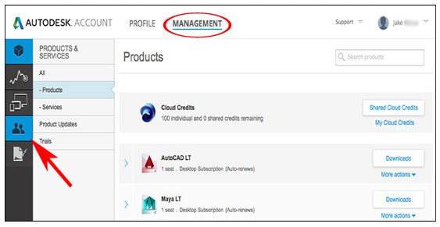

Slide 4
The User List is the primary interface for managing users in your Autodesk Account. Click the arrow next to a user name to display the following information:
Name & Email Address: Used to sort users and grant access to Account benefits.
Product & Services: Number of software assets or cloud services assigned to a user.
Benefits: Items such as access to software downloads and customer support.
Status: A check indicates the user has accessed assigned benefits.

Slide 5
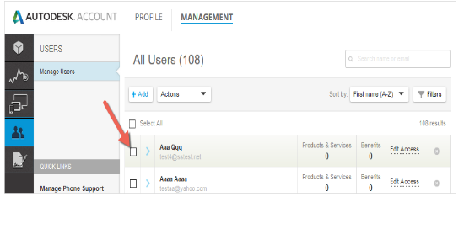

Slide 6
Adding Users
Autodesk Account allows you to add single users and assign benefits or enter a list of multiple users and assign the same benefits to all users at one time. When you add a user, they will receive a confirmation email that tells them how to create an Autodesk account and create their own password. Users can then use the account portal to access support and product downloads, and track their cloud service usage and cloud credit consumption.
To add a single user:
Click the + Add button to activate the Add Users window.
Enter the email address, first name and last name (all are required). The email address is the user's Autodesk ID used to access his/her Autodesk Account.
Check "I'd like to add access to the user(s) now" if you wish to manage access to products and benefits. Note: Added users will have access to an Autodesk Account, but will not have access to products and benefits until they are assigned.
Click the Save & Continue button or Add Another User if adding more than one user individuall

Slide 7
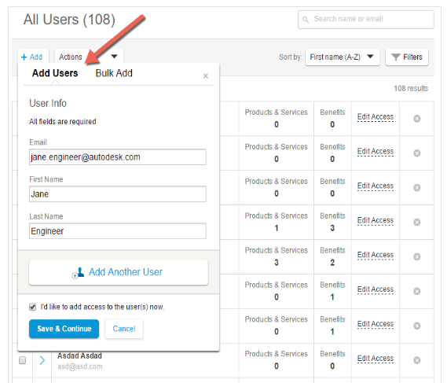

Slide 8
To add multiple users:
Click the + Add button to activate the Add Users window.
Click Bulk Add.
Type or paste a list of users into the entry field following the example provided. (As many as 50 users can be entered at one time).
Check "I'd like to add access to the user(s) now" if you wish to manage access to products and benefits. Note: Added users will have access to an Autodesk Account, but will not have access to products and benefits until they are assigned.
Click the Save & Continue button

Slide 9
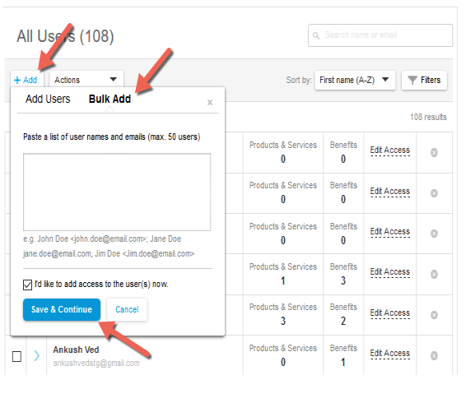

Slide 10
To remove or delete a user:
Follow the instructions in Setting User Permissions for Products, Services & Support to unassign all software and services before removing a user from an account. Deleting a user from an account does not remove software and service permissions or delete that user's Autodesk Account.
Locate the name of the user you wish to remove and click the "X" on the user record.
Click the Remove button to confirm that you wish to remove the user from all contracts or click Cancel.

Slide 11
